Slide 1
SEO Audit Report
Content and Technical
- Jaismine Kaur

Slide 2
Instructions:
This Live Project has 2 parts: Part 1: Analysing upGrad SEO Audit report; Part 2: Analysing your Blogs’ SEO Audit Report.
You will analyse the SEO audit report for upgrad.com and suggest ways to optimise for a better SEO score. Similarly, you will analyse the SEO audit report for your blog using SEO Meta in 1 click
You need to provide (any) two optimisation techniques for content and (any) two for technical.

Slide 3
PART A

Slide 4
Content SEO
From the SEO audit report given, suggest ways to perform Content SEO.
Your Answer:
The page doesn’t contain any H1 tags. H1 headings help indicate the important topics of a page to the search engine. They help define the topic of the page to the search engine.

Slide 5
Content SEO
From the SEO audit report given, suggest ways to perform Content SEO.
Your Answer:
The images are missing the alternate text, which is important for the accessibility to the disabled people, as well as displaying a description of the image if the image source is broken or the internet connection s slow. Search engines also interpret the subject of the images better with the relevant keywords.

Slide 6
Technical SEO
From the SEO audit report given, suggest ways to perform Technical SEO.
Your Answer
As the audit shows, the robot.txt file is missing from the site. A robots.txt file tells search engine crawlers which URLs the crawler can access on the site and which content should remain private. This is used mainly to avoid overloading the site with requests, and reduces load time of the server.

Slide 7
Technical SEO
From the SEO audit report given, suggest ways to perform Technical SEO.
Your Answer
The size of the page’s HTML is much greater than the average size. This can lead to slower loading time, more bounce rate, and decreased revenue. TO reduce the HTML size: use HTML compression, CSS layouts, external style sheers, and move javascript to external files.

Slide 8
PART B

Slide 9
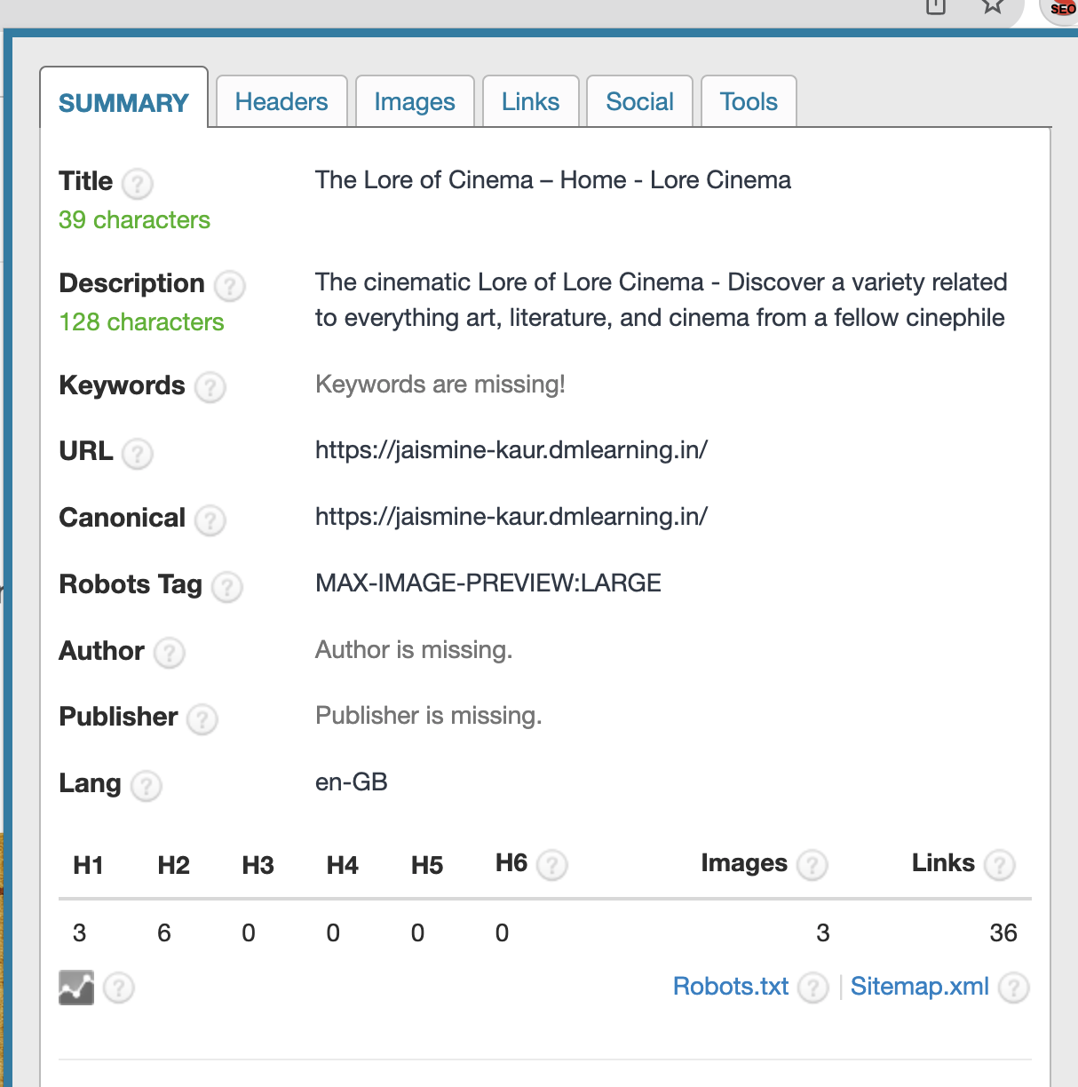
Attach your Blog’s SEO Report from SEO Meta in 1 click (in the form of screen shots) ( Summary Tab)

Slide 10
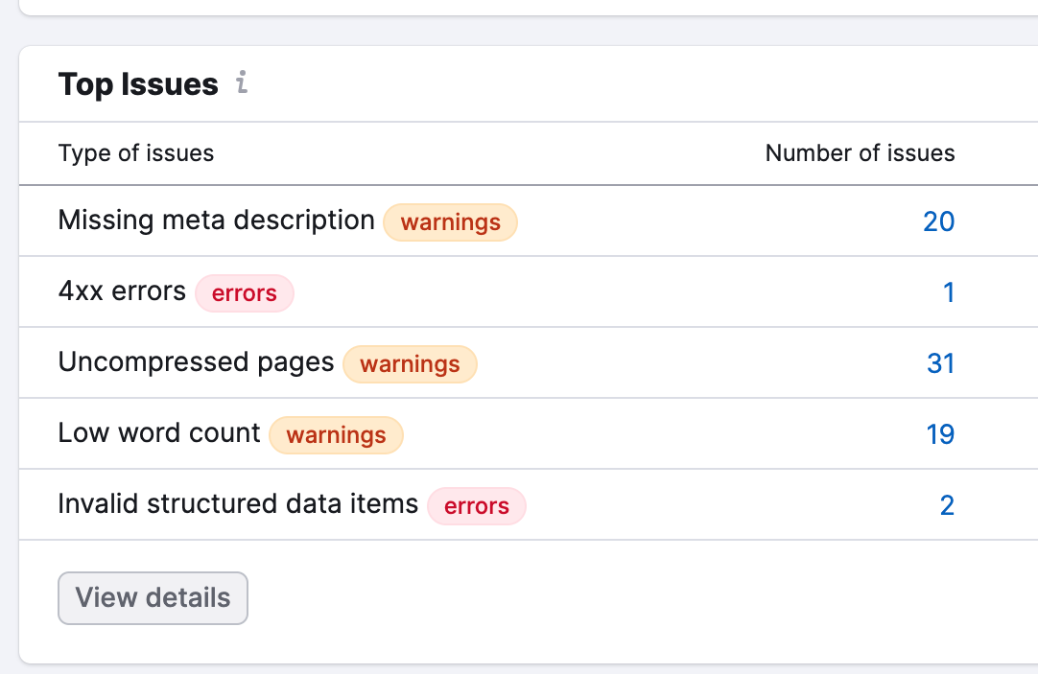
Q1. Identify two content and two technical gaps for your webpage. State relevant optimisation techniques for the same.
Your Answer
Technical: 1. The page loading speed is high (I can enable gzip compression for the text and improve initial server response time by enabling server side caching)
2. The “about us” page is giving an error 404 (can replace the broken link)
Content: 1. A few pages are missing meta descriptions (can add meta descriptions to all with relevant keywords)
2. There is a low word count on a lot of the pages (I can make the word count above 200 on every page for indelibility on the search engine)

Slide 11
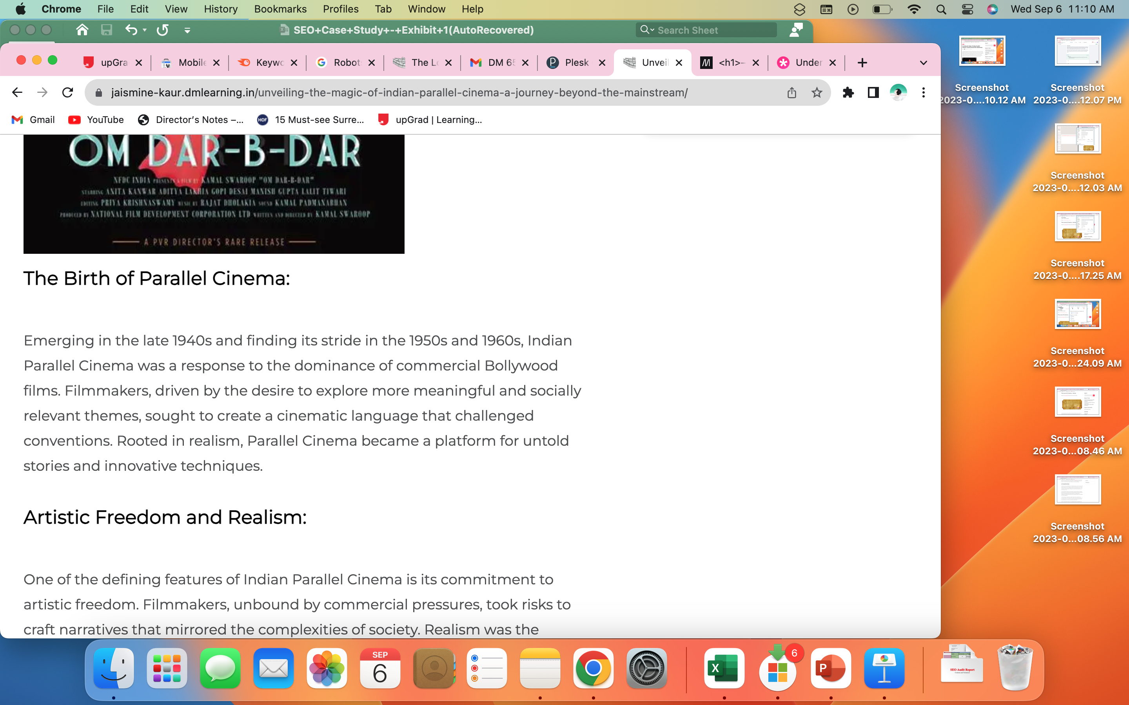
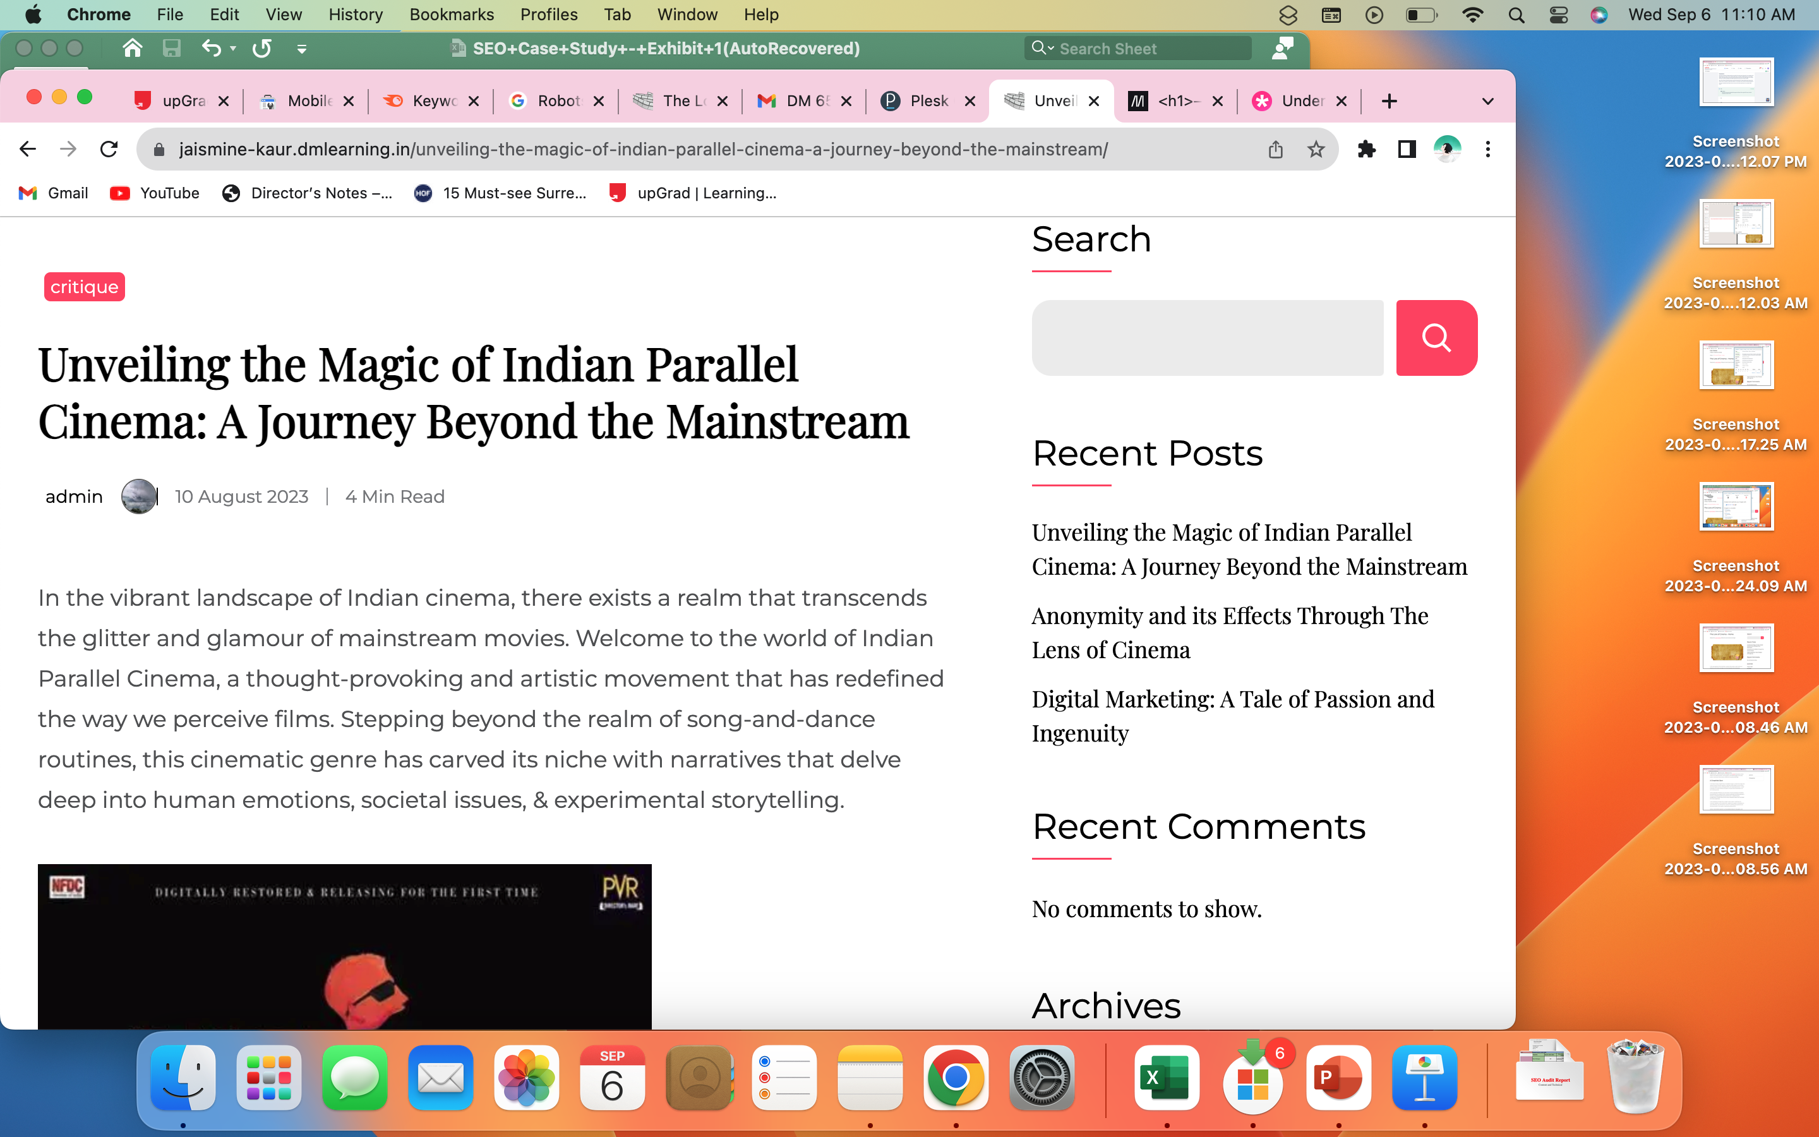
Q2. Identify the Title tag, H1, H2 and H3 tags for any of your blog pages.
Your Answer
H2
H1
H3

Slide 12
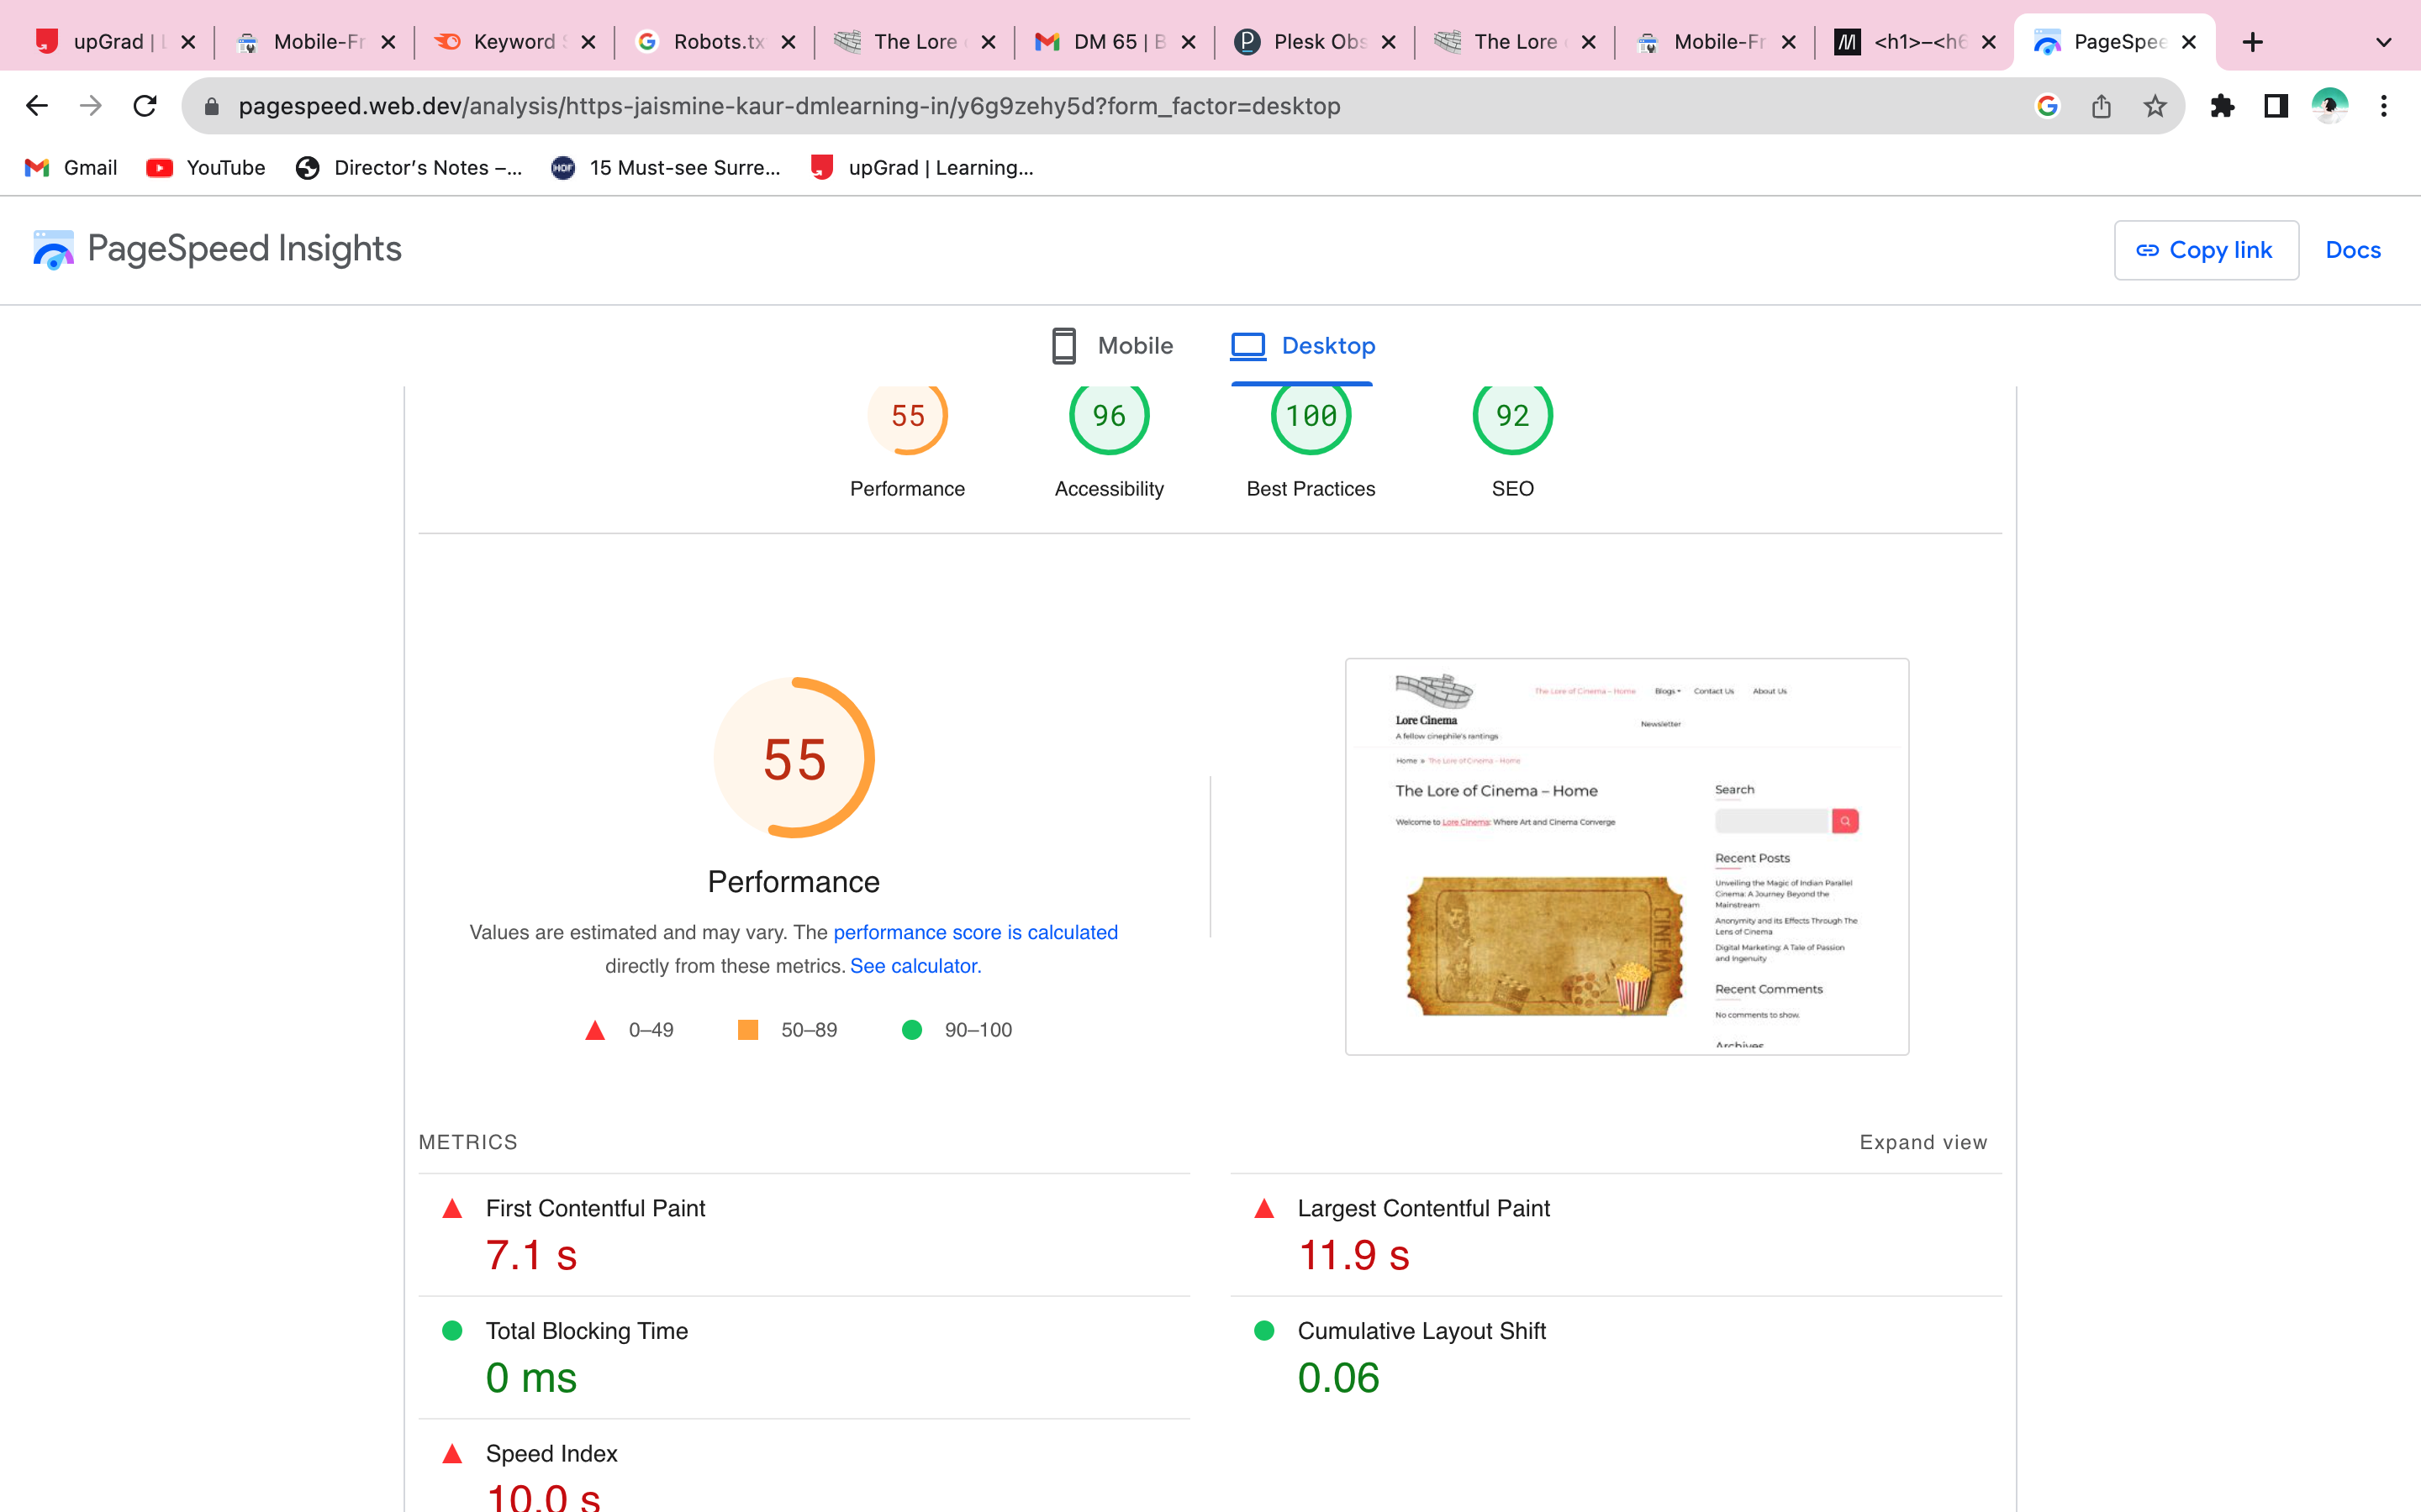
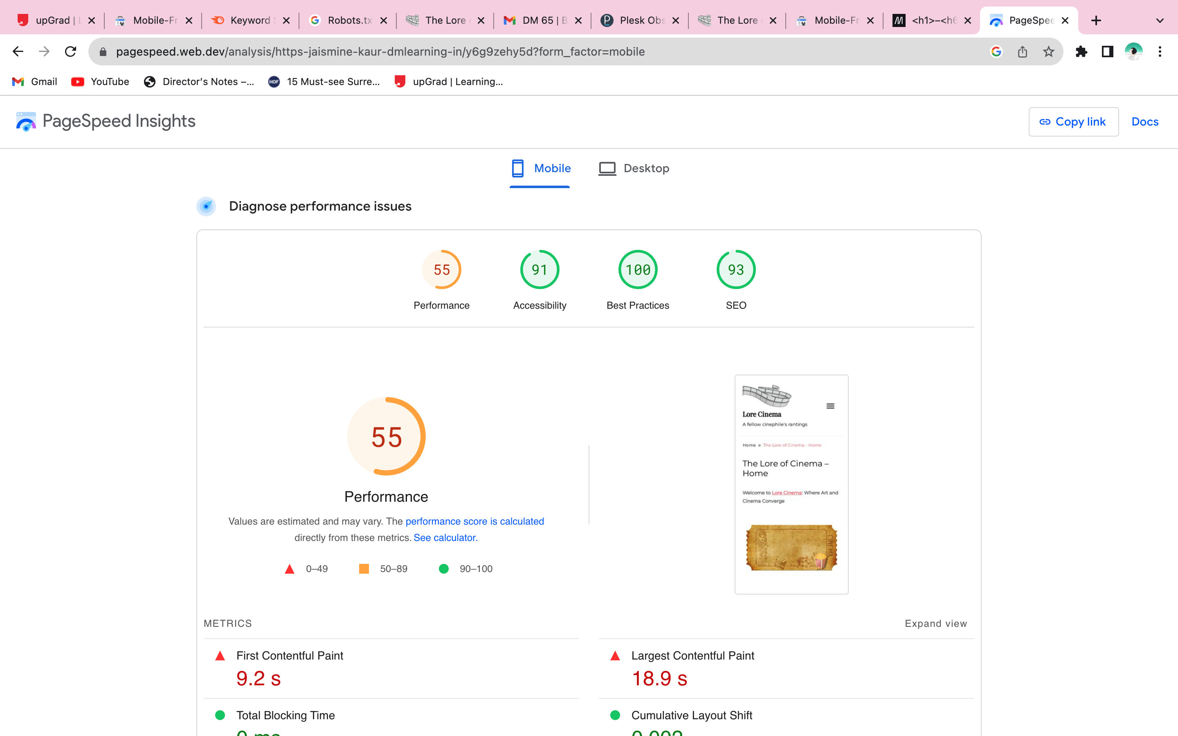
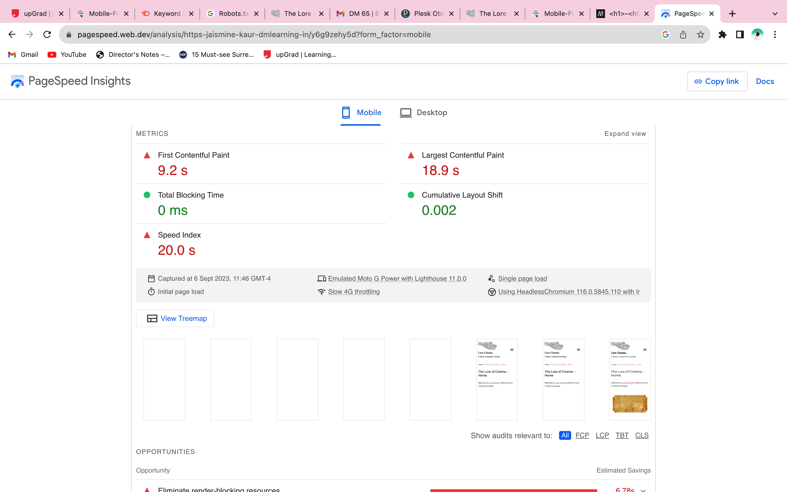
Q3. What is your website’s desktop and mobile page speed; and how can you improve it?
Your Answer
As the performance is low along with the speed, I can minify CSS, Javascript, and HTML. I can also enable cache and optimize image for the web while compressing it.

Slide 13
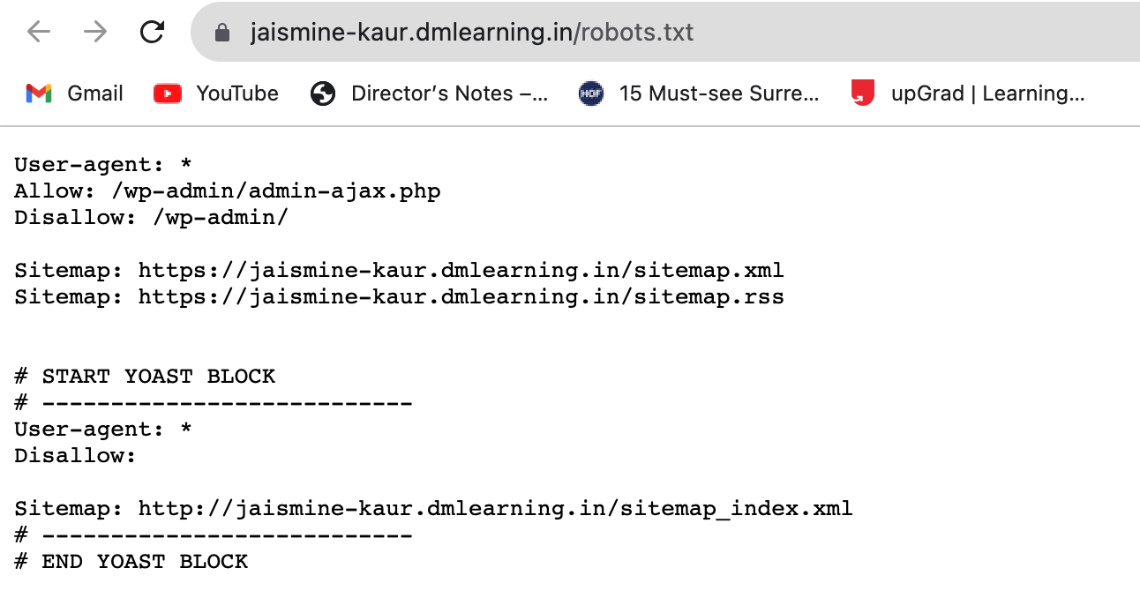
Q4. Study your report and identify if your blog has a robot.txt file?
Your Answer
When opening the link with /robot.txt, the page shows allowed and disallowed links. Thus the site has a robot.txt file.

